Slide 1


Slide 2
Outline
Basic Logic Gates

Slide 3
3.1 Basic Logic Gates
  Inverter
  AND Gate
  OR Gate
  NAND Gate
  NOR Gate
  Exclusive-OR
  Exclusive-NOR Gate

Slide 4
3.1.1 The Inverter
Changes one logic level to the opposite level
  A 1 to a 0
  A 0 to a 1
Inverter Truth Table
INPUT | OUTPUT
Low (0) | High (1)
High (1) | Low (0)

Slide 5
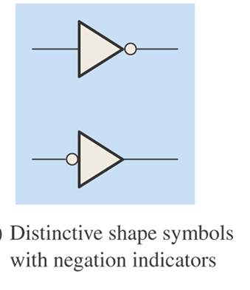

Slide 6
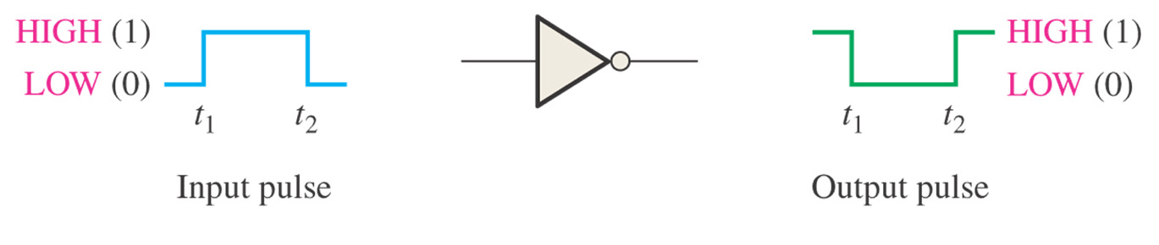
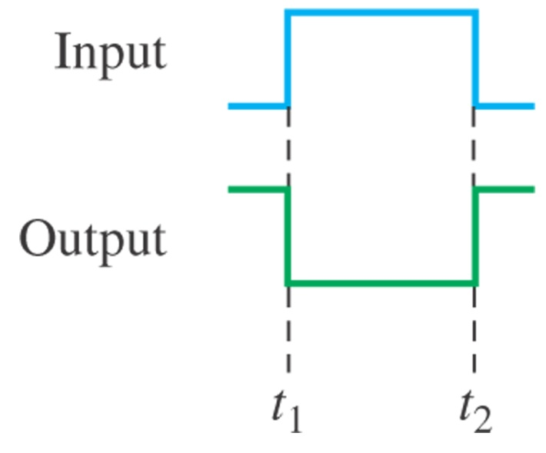

Inverter Operation and Timing Diagram

Slide 7
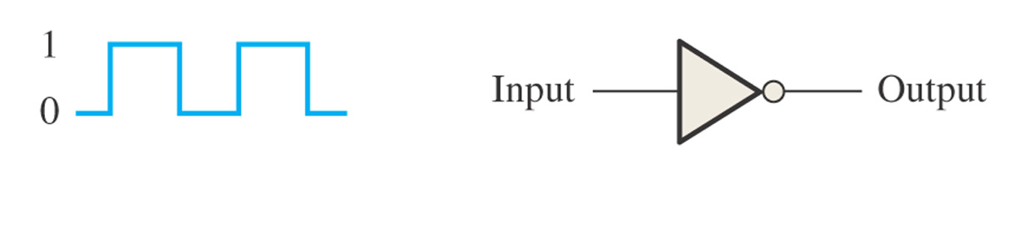
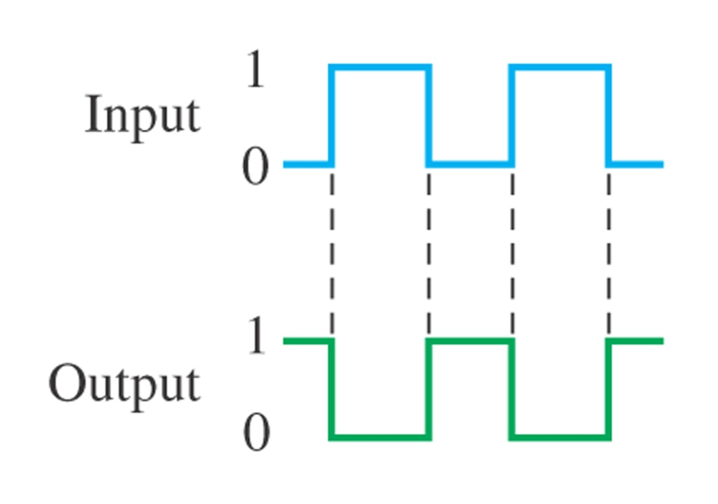
Example.
Determine the output waveform corresponding to the input and show the timing diagram.

Slide 8
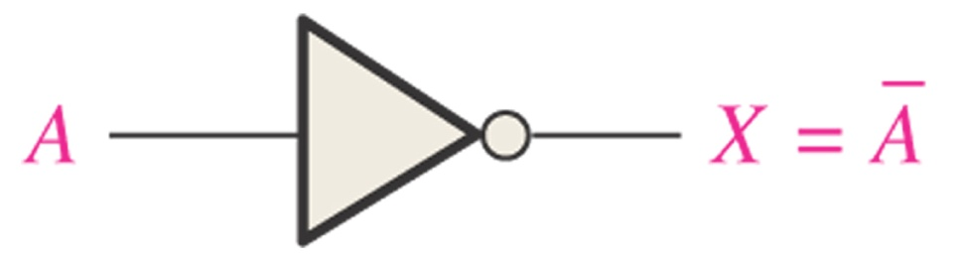
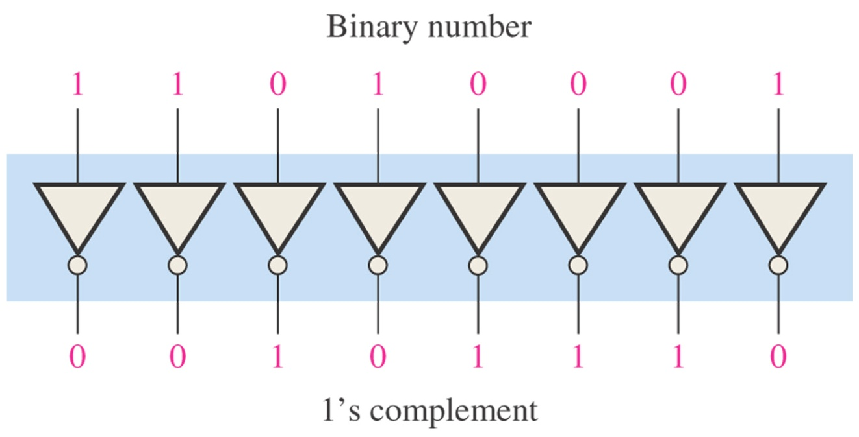
Logic Expression for an Inverter

Slide 9
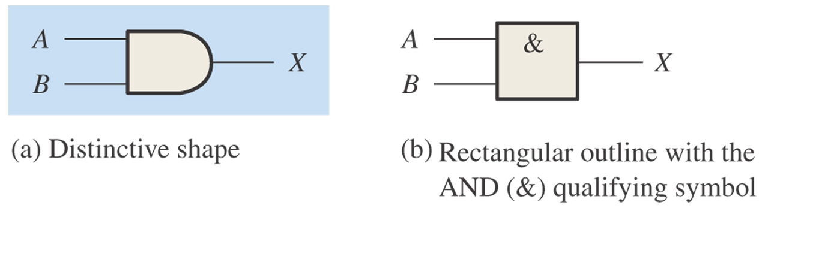
3.1.2 The AND Gate
One of the basic gates that can be combined to form any logic function
Have two or more inputs and one output
Produce a HIGH output only when all of the inputs are HIGH

Slide 10
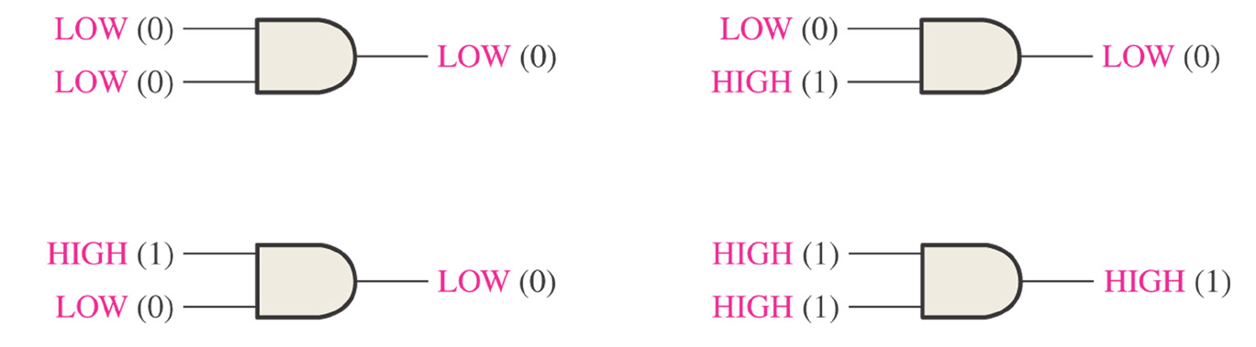
Truth Table for a 2-input AND gate
INPUT |  | OUTPUT
A | B | X
0 | 0 | 0
0 | 1 | 0
1 | 0 | 0
1 | 1 | 1

Slide 11
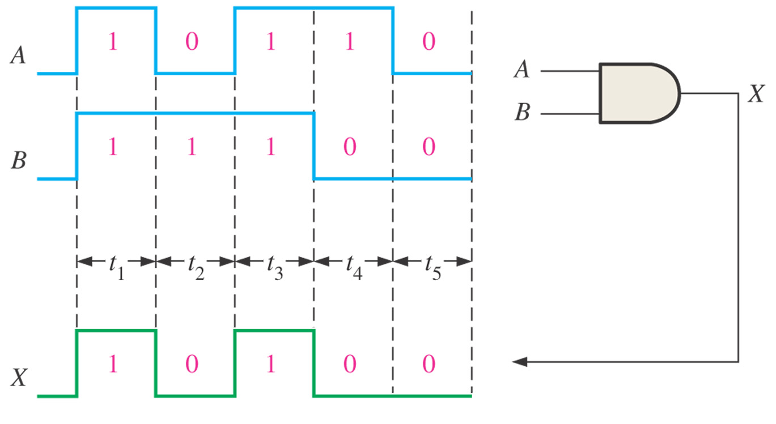

Slide 12
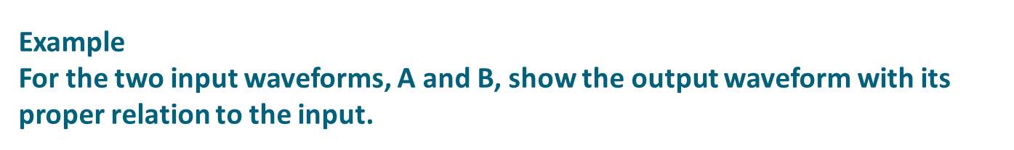
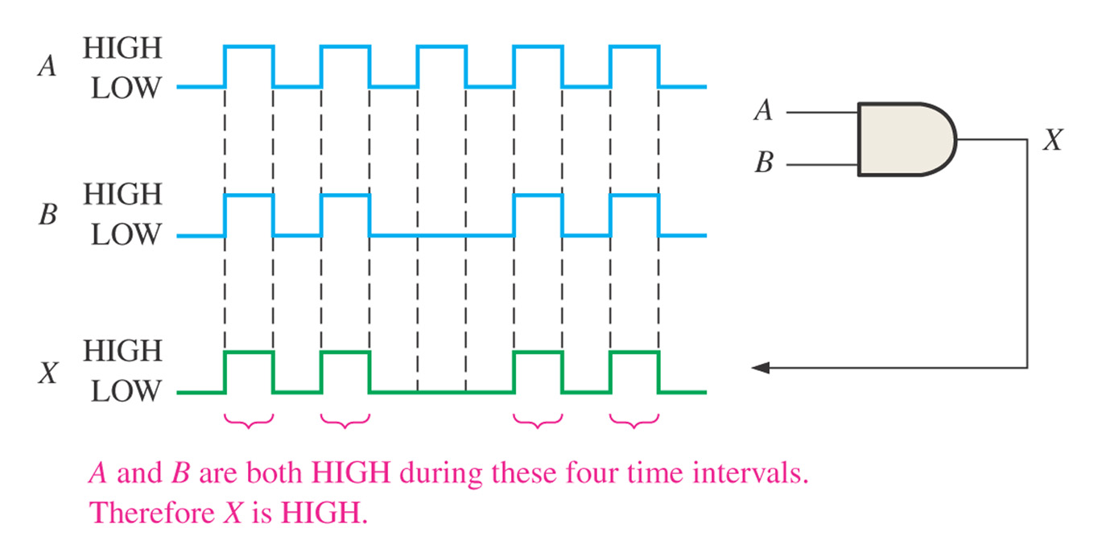

Slide 13
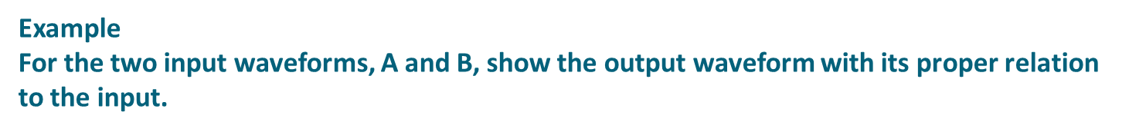
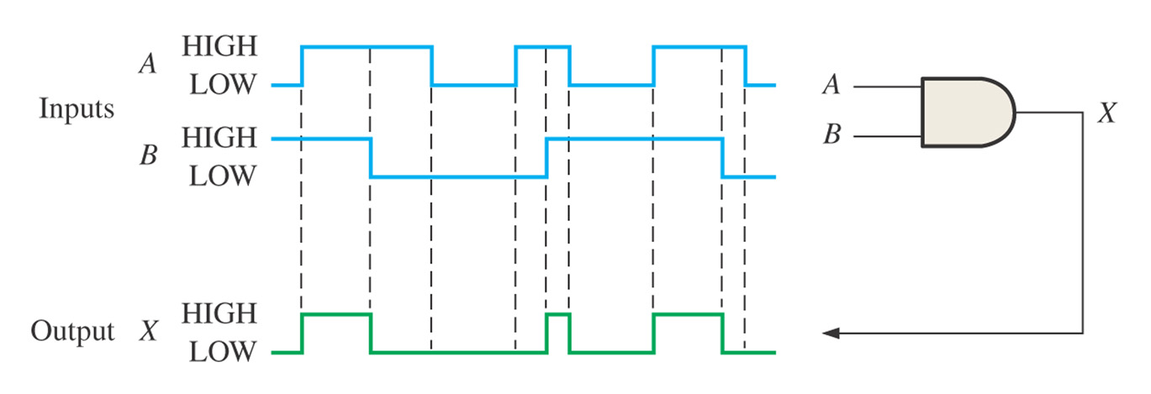

Slide 14
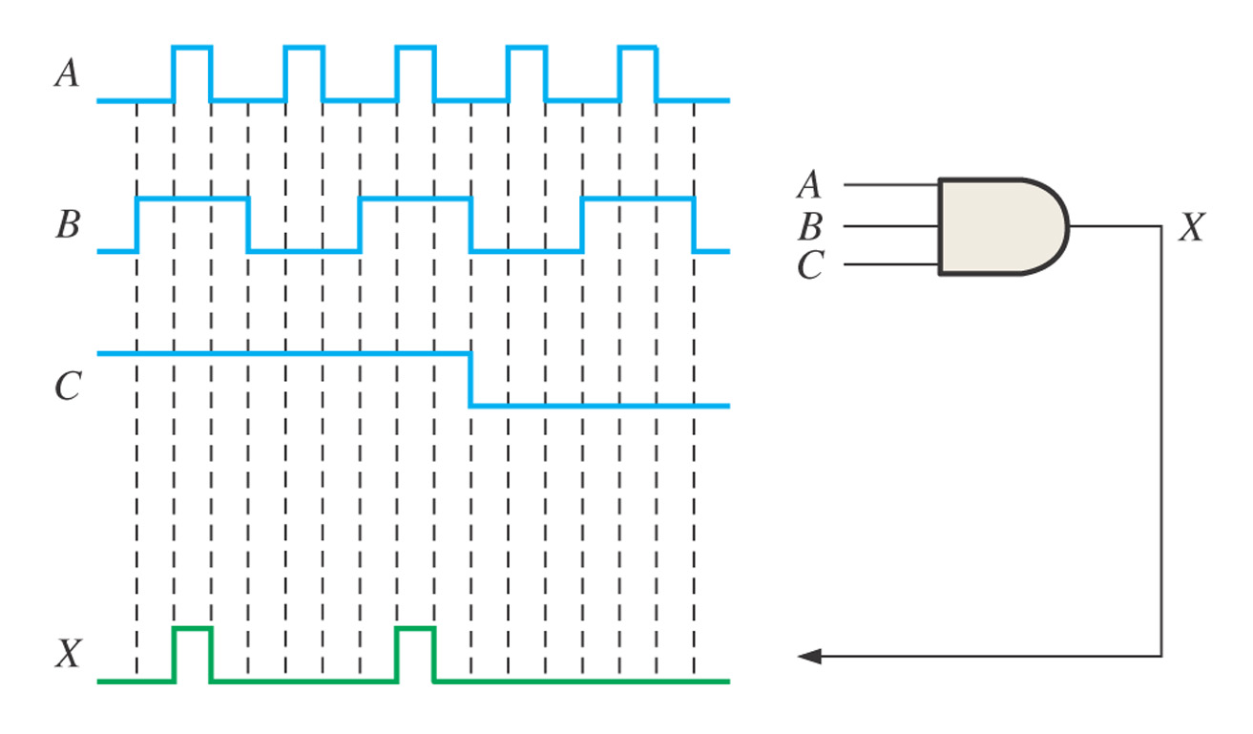

Slide 15
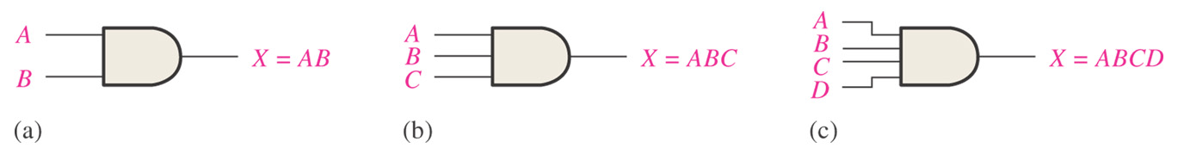
Logic Expressions for an AND Gate

Slide 16
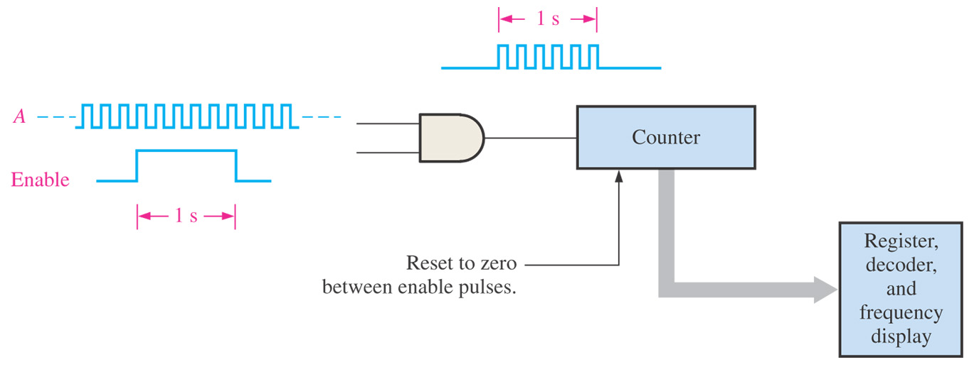

Slide 17
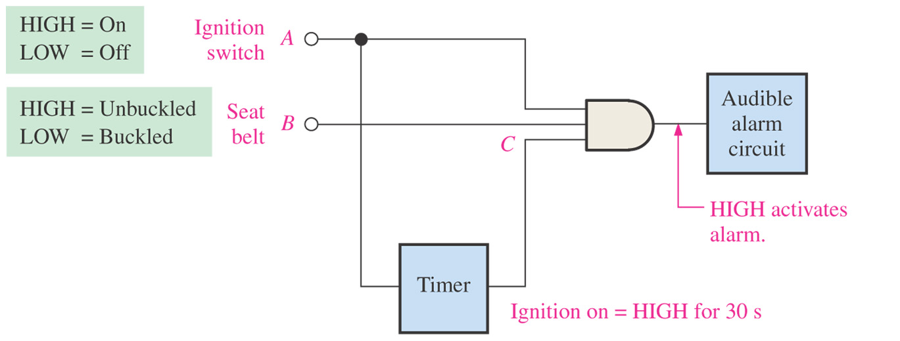

Slide 18
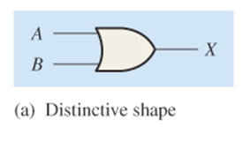
3.1.3 The OR Gate
One of the basic gates
Have two or more inputs

Slide 19
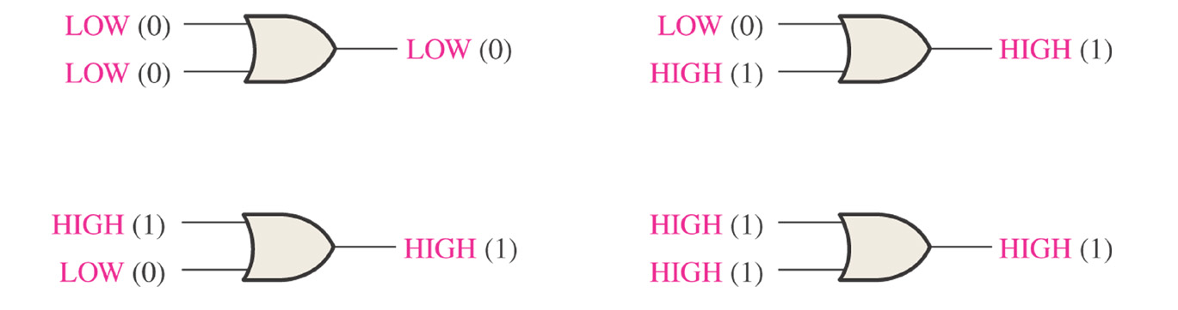
Operation of an OR Gate

Slide 20
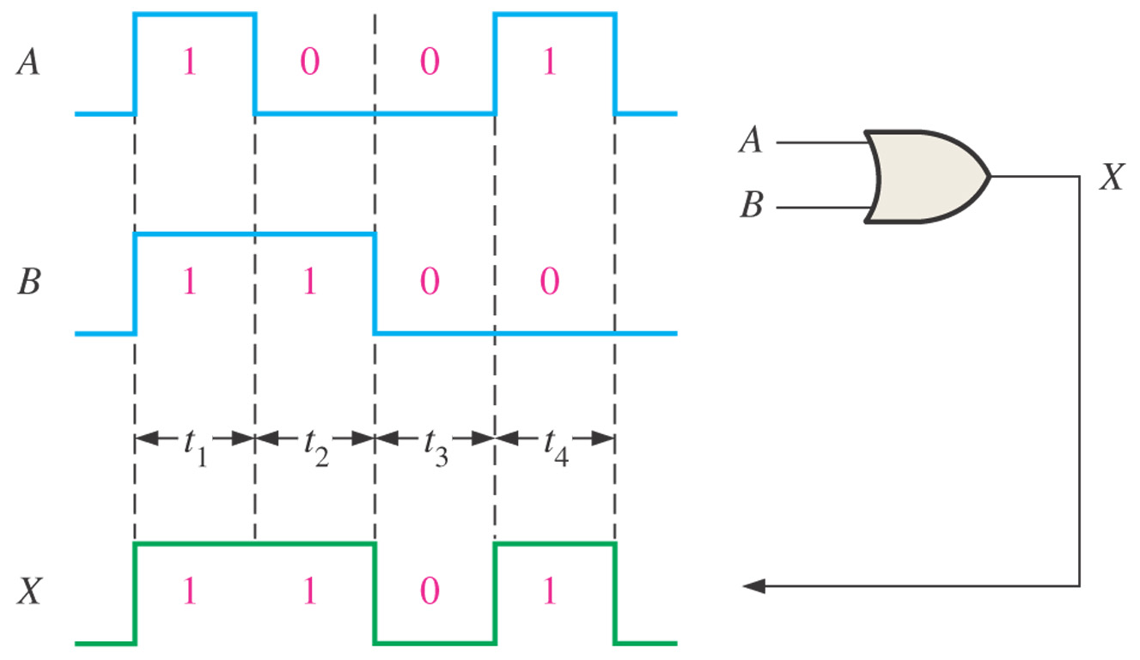
Operation with Waveform Inputs

Slide 21
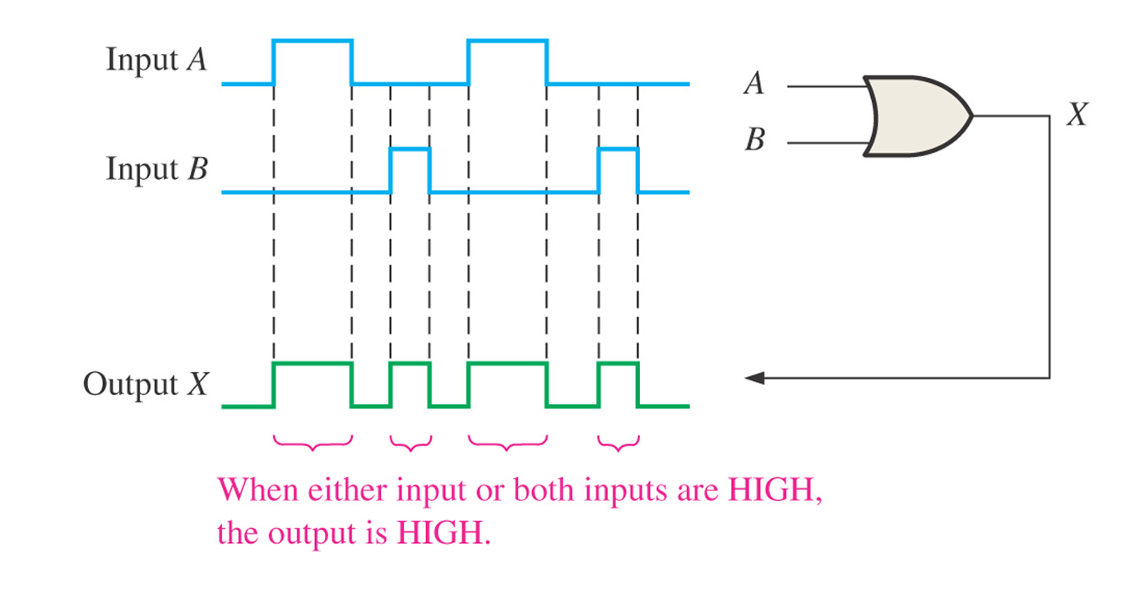

Slide 22
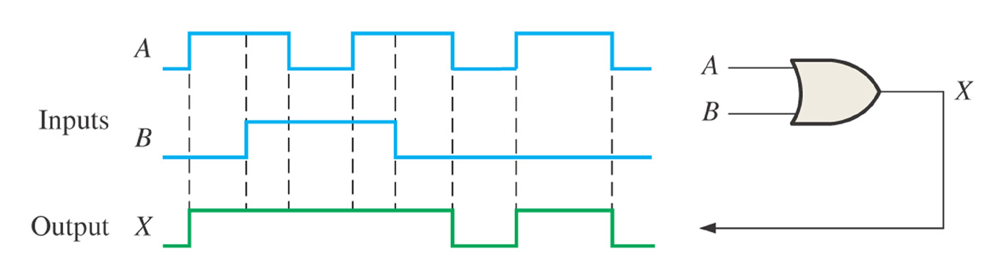
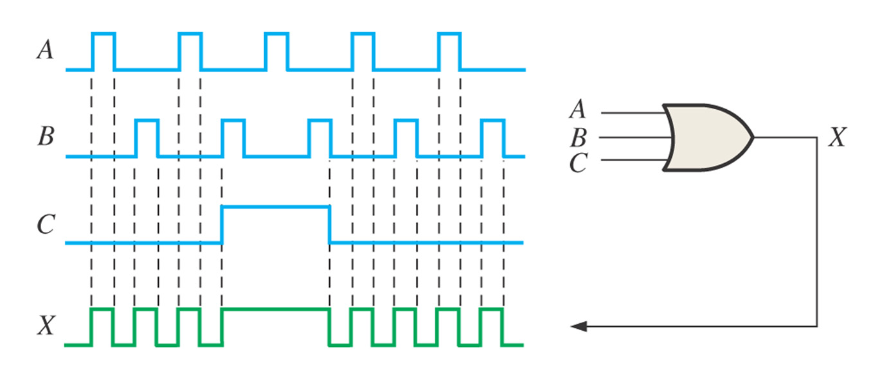
Figure 3–21
Figure 3–22

Slide 23
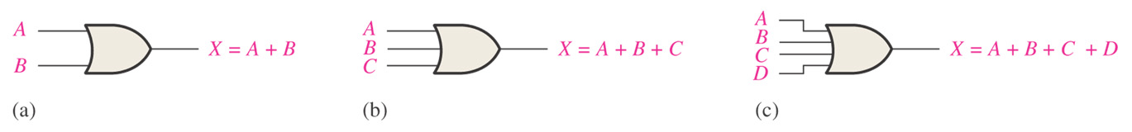

Slide 24
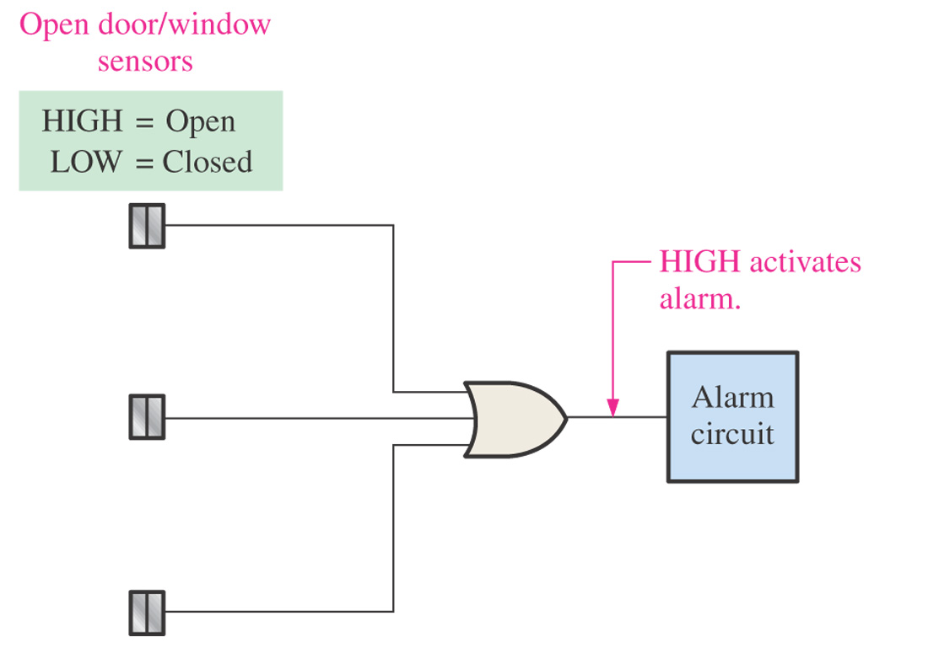

Slide 25
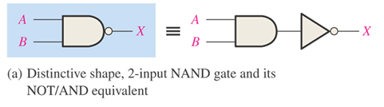
3.1.4 The NAND Gate
A popular logic element
Can be used in combination to perform the AND, OR, and inverter operation.

Slide 26
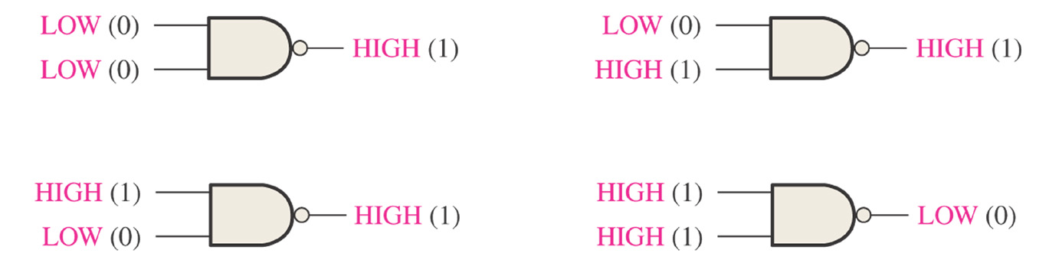

Slide 27

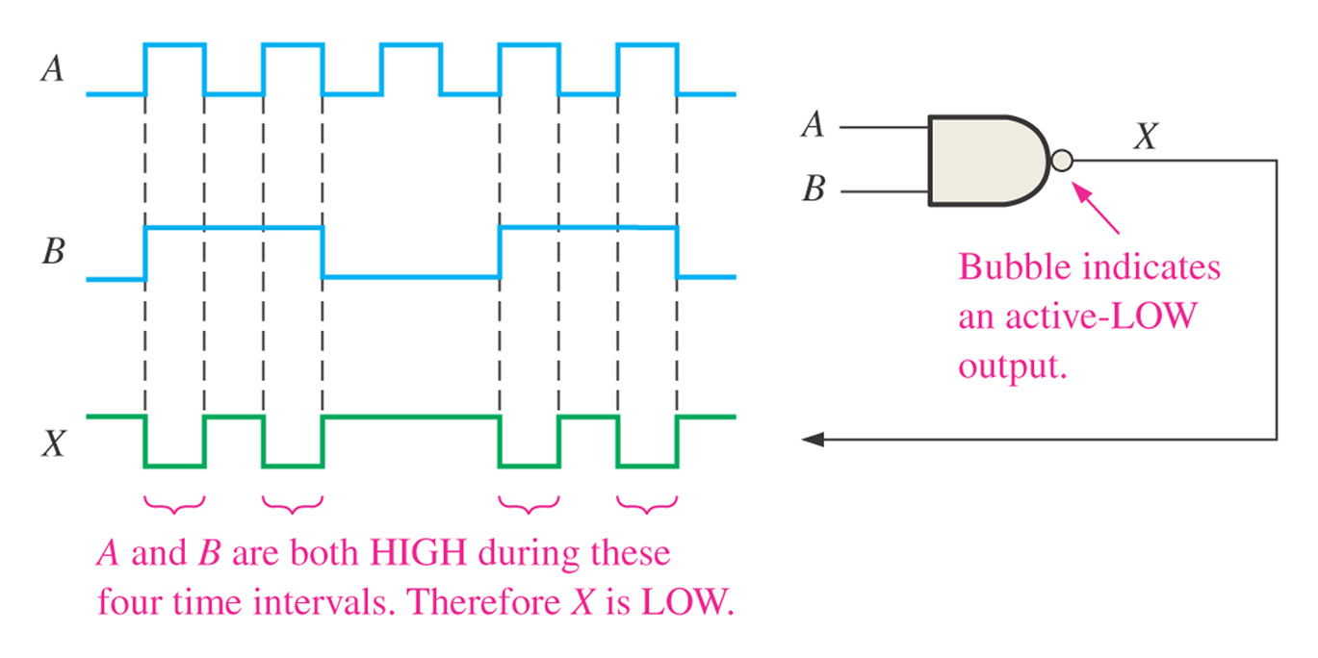

Slide 28
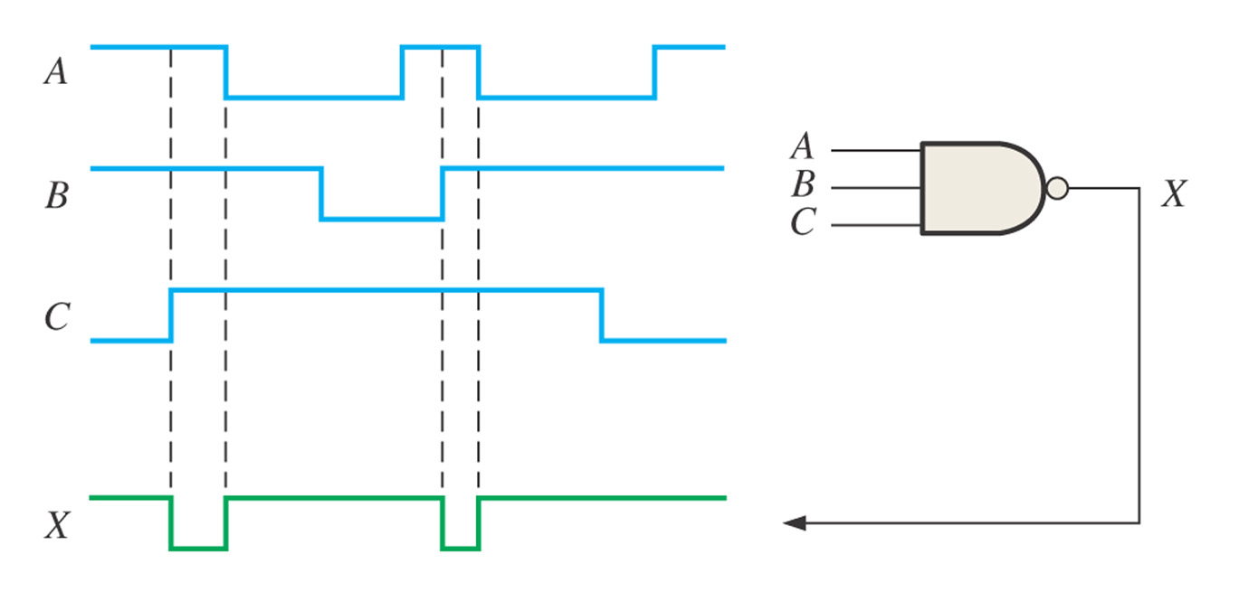

Slide 29
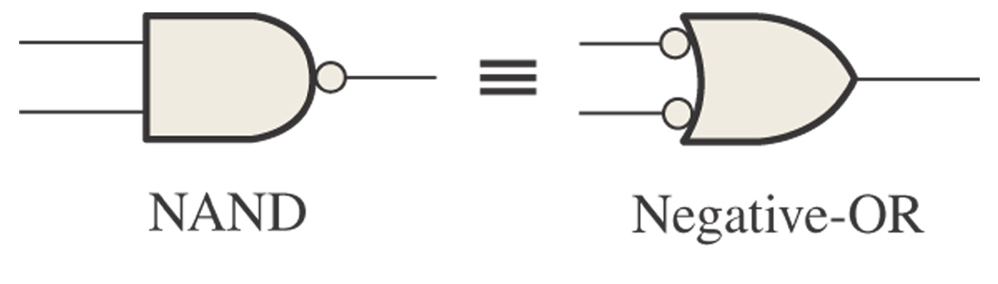
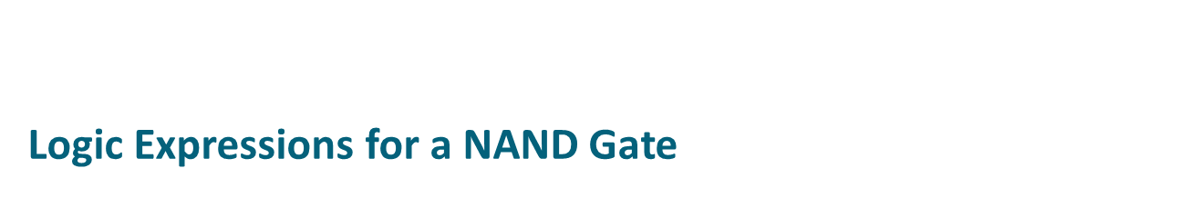
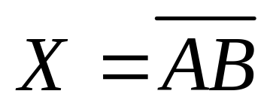
Negative-OR Equivalent Operation of a NAND Gate

Slide 30
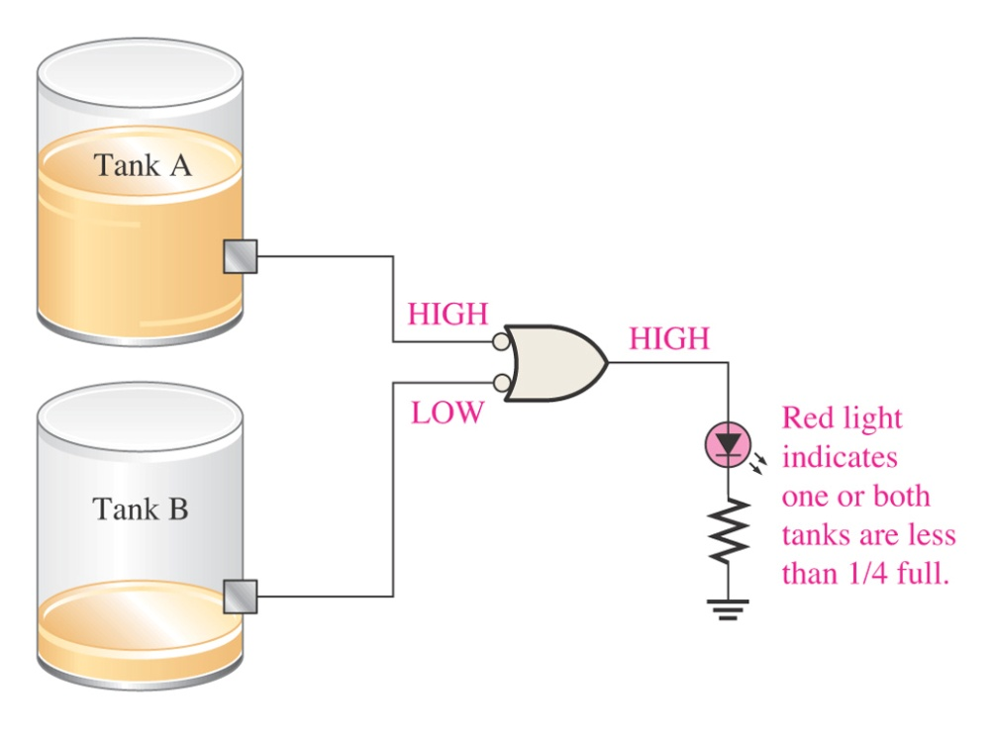
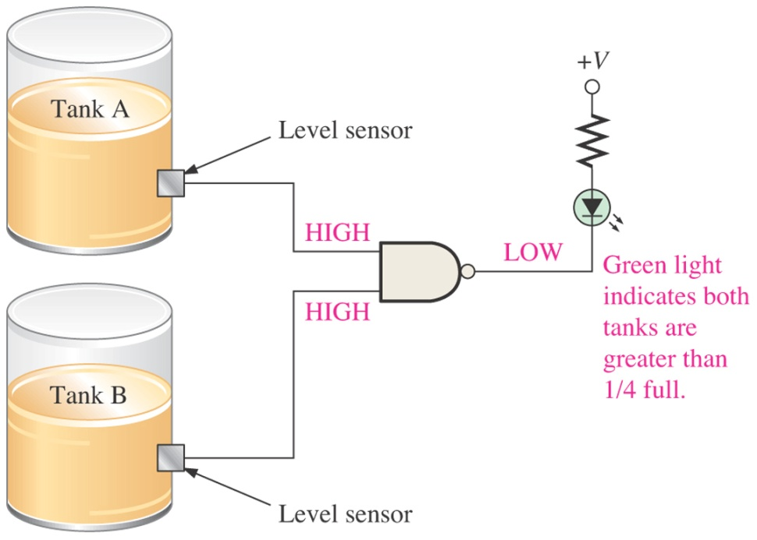
Figure 3–30 An application

Slide 31
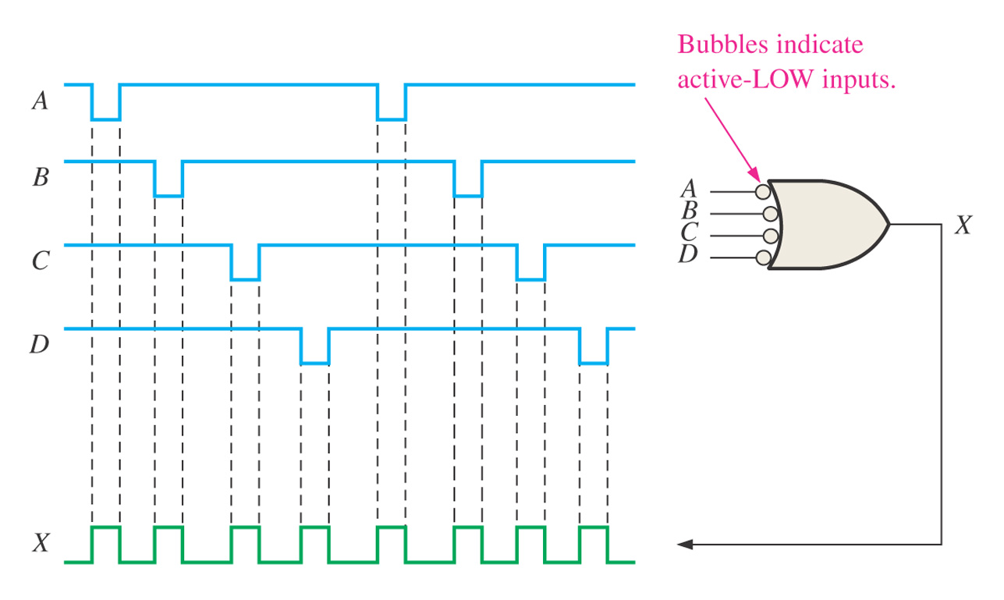

Slide 32
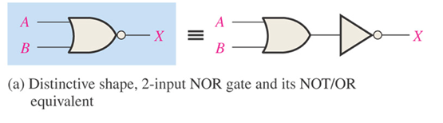
3.1.5 The NOR Gate
A useful logic element
Can be used in combination to perform the AND, OR, and inverter operations.

Slide 33
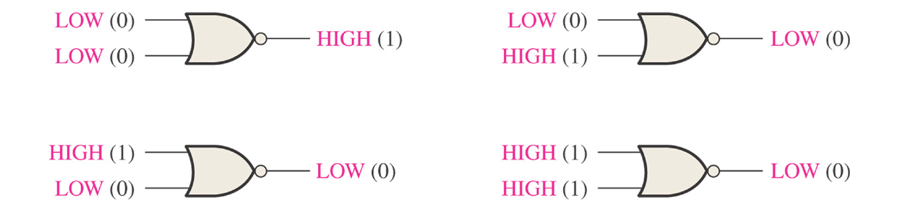

Slide 34
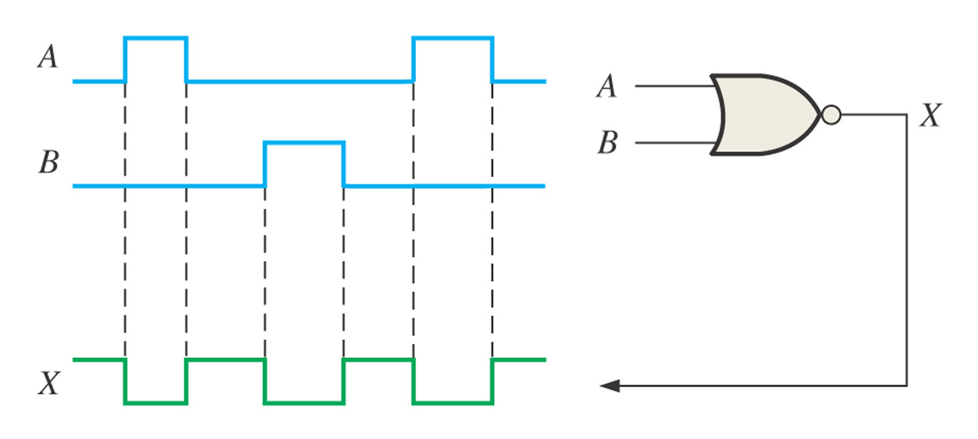

Slide 35
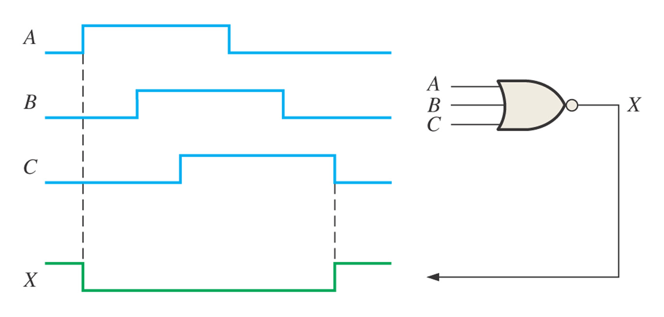

Slide 36
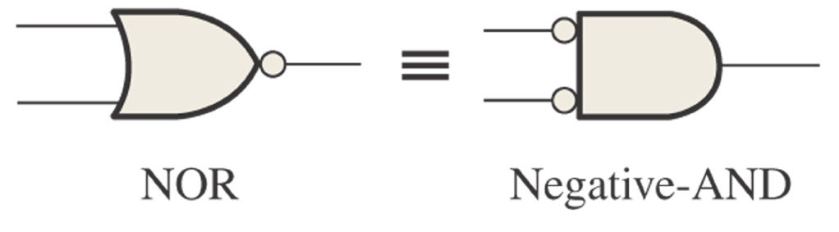
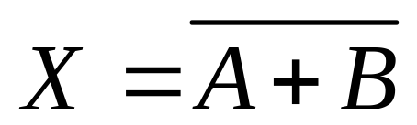
Logic Expressions for a NOR Gate
Negative-AND Equivalent Operation of the NOR Gate

Slide 37
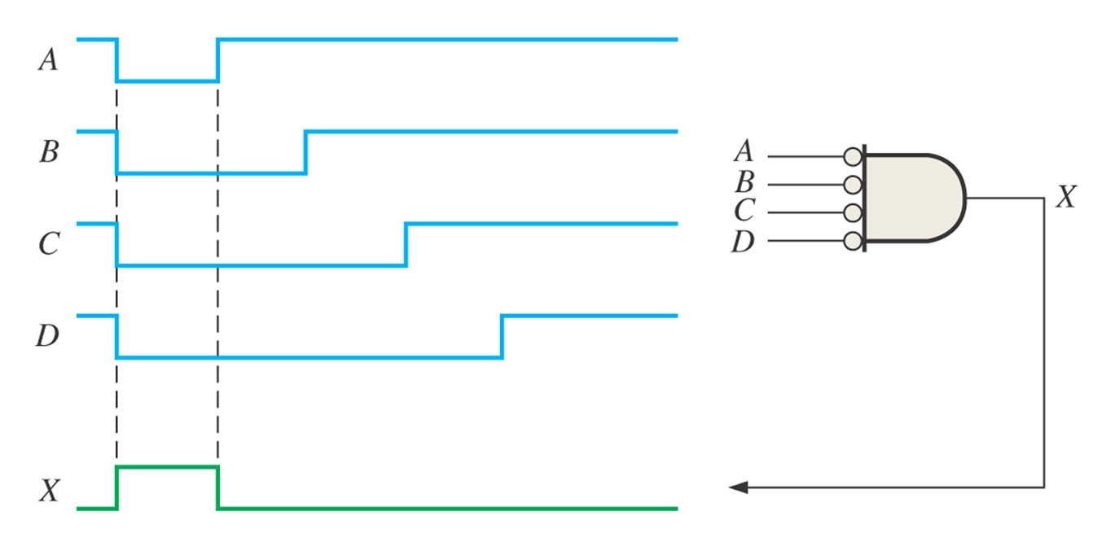

Slide 38
3.1.6 The Exclusive-OR and Exclusive-NOR Gates
Are formed by a combination of other gates
Are often treated as basic logic elements with their own unique symbols

Slide 39
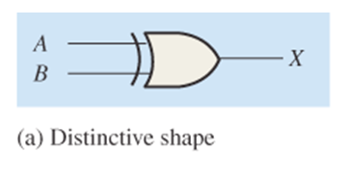
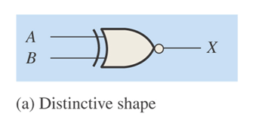
The Exclusive-OR （异或）Gate
The Exclusive-NOR （异或非，同或）gate

Slide 40
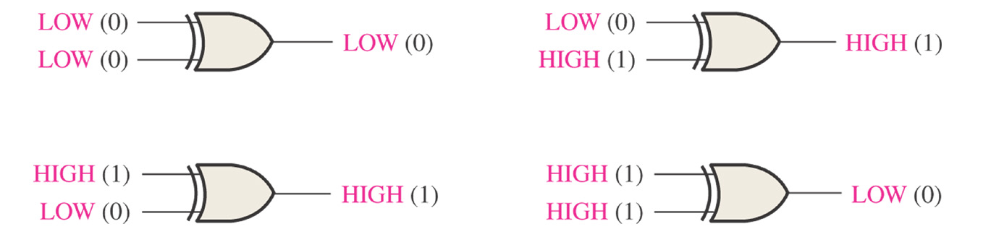

Slide 41
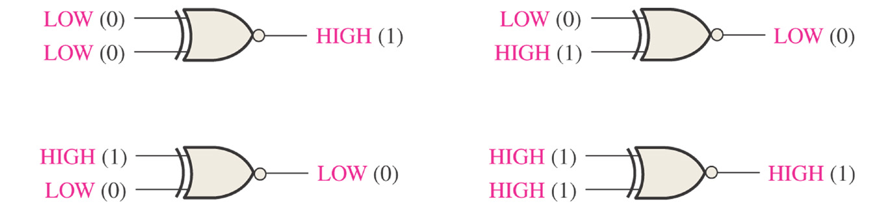

Slide 42
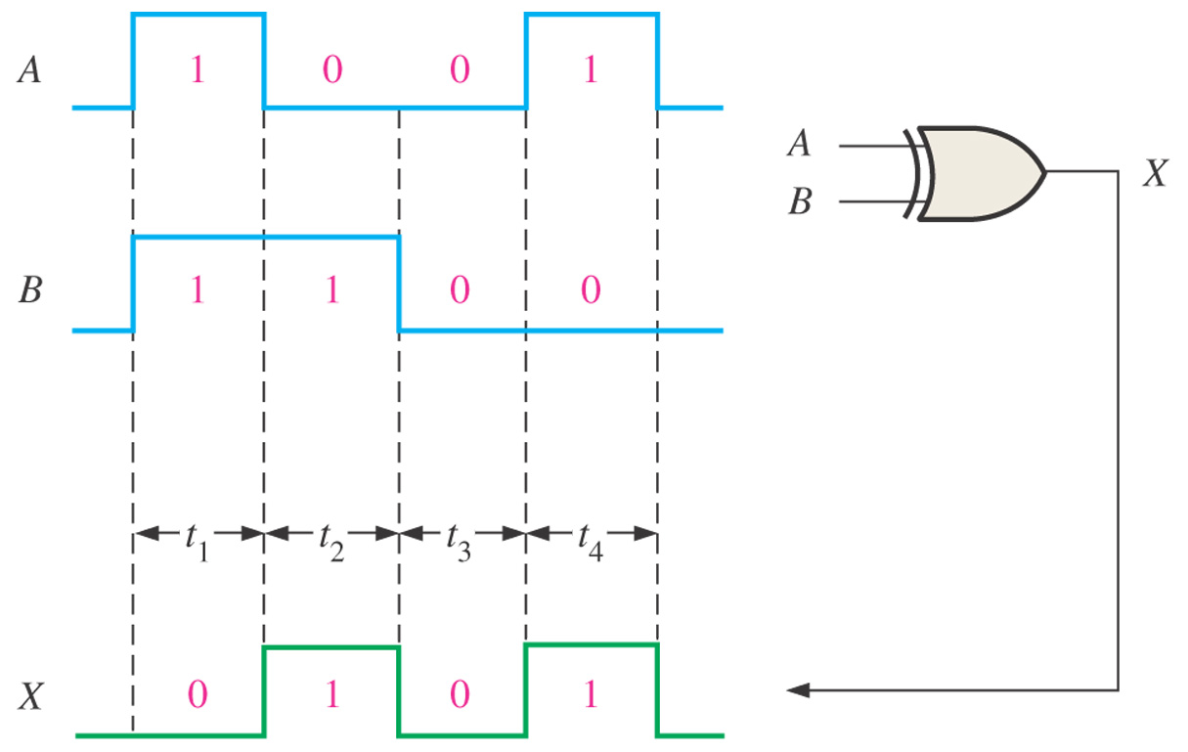

Slide 43
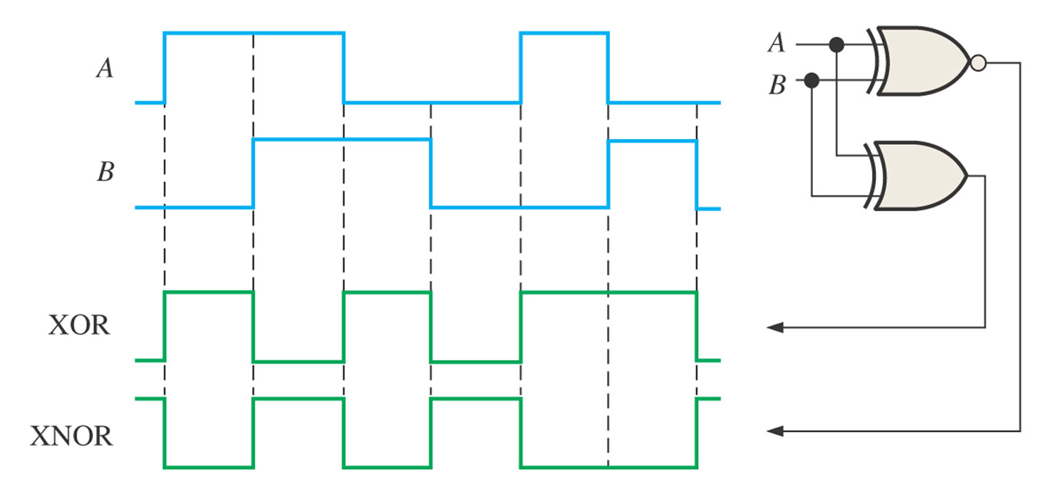

Slide 44
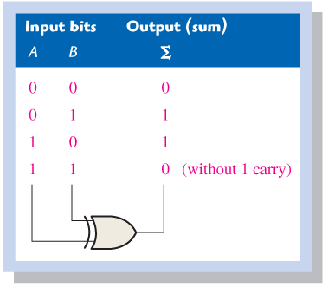

Slide 45
HW
Page 103~104
  12
  20

